Slide 1
CSE 260
DIGITAL LOGIC DESIGN
Counters
BRAC University
1

Slide 2
Introduction: Counters
Counters are circuits that cycle through a specified number of states.
Two types of counters:
  synchronous (parallel) counters
  asynchronous (ripple) counters
Ripple counters allow some flip-flop outputs to be used as a source of clock for other flip-flops.
Synchronous counters apply the same clock to all flip-flops.

Slide 3
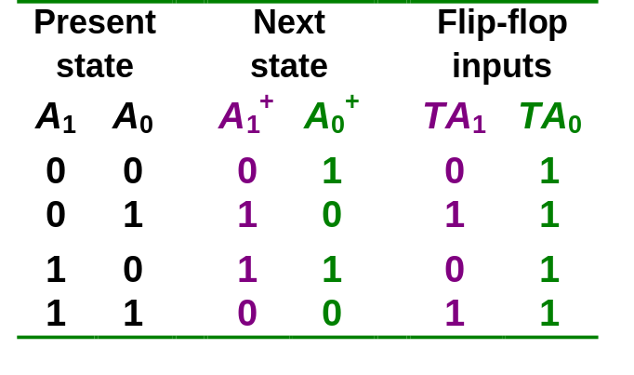
Synchronous (Parallel) Counters
Synchronous (parallel) counters: the flip-flops are clocked at the same time by a common clock pulse.
We can design these counters using the sequential logic design process.
Example: 2-bit synchronous binary counter (using T flip-flops, or JK flip-flops with identical J,K inputs).
00
01
11
10

Slide 4
Synchronous (Parallel) Counters
Example: 2-bit synchronous binary counter (using T flip-flops, or JK flip-flops with identical J,K inputs).
TA₁ = A₀
TA₀ = 1
1
J
A₀
J
A₁
Q
Q
Q
C
C
Q'
Q'
K
Q'
K
CLK

Slide 5
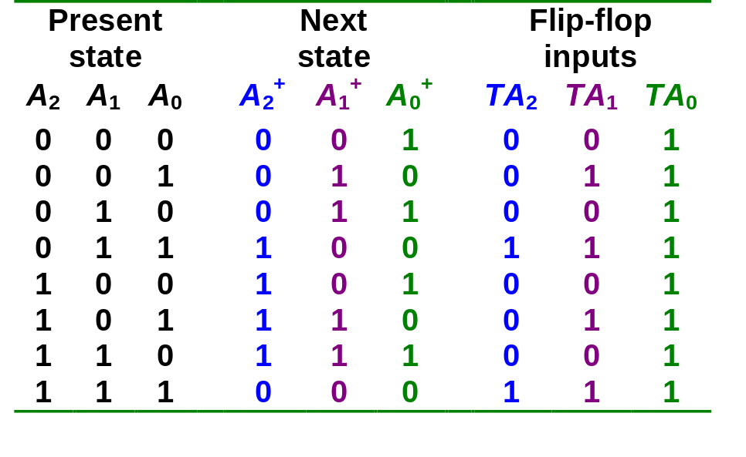
Synchronous (Parallel) Counters
Example: 3-bit synchronous binary counter (using T flip-flops, or JK flip-flops with identical J, K inputs).
A₁
A₁
A₁
1
1
1
1
1
1
1
A₂
1
A₂
1
1
A₂
1
1
1
1
A₀
A₀
A₀
TA₂ = A₁.A₀
TA₁ = A₀
TA₀ = 1

Slide 6
Synchronous (Parallel) Counters
Example: 3-bit synchronous binary counter (cont’d).
  TA₂ = A₁.A₀ TA₁ = A₀ TA₀ = 1
A₂
A₁
A₀
Q
Q
Q
J
K
J
K
J
K
CP
1

Slide 7
Synchronous (Parallel) Counters
Note that in a binary counter, the n^{th} bit (shown underlined) is always complemented whenever
  011…11 → 100…00
  or 111…11 → 000…00
Hence, X_{n} is complemented whenever X_{n-1}X_{n-2} ... X₁X₀ = 11…11.
As a result, if T flip-flops are used, then TX_{n} = X_{n-1} . X_{n-2} . ... . X₁ . X₀

Slide 8
Synchronous (Parallel) Counters
Example: 4-bit synchronous binary counter.
  TA₃ = A₂ . A₁ . A₀
  TA₂ = A₁ . A₀
  TA₁ = A₀
  TA₀ = 1
1
A₁.A₀
A₂.A₁.A₀
J
A₀
J
A₁
J
A₂
J
A₃
Q
Q
Q
Q
Q
C
C
C
C
Q'
Q'
Q'
Q'
K
Q'
K
K
K
CLK

Slide 9
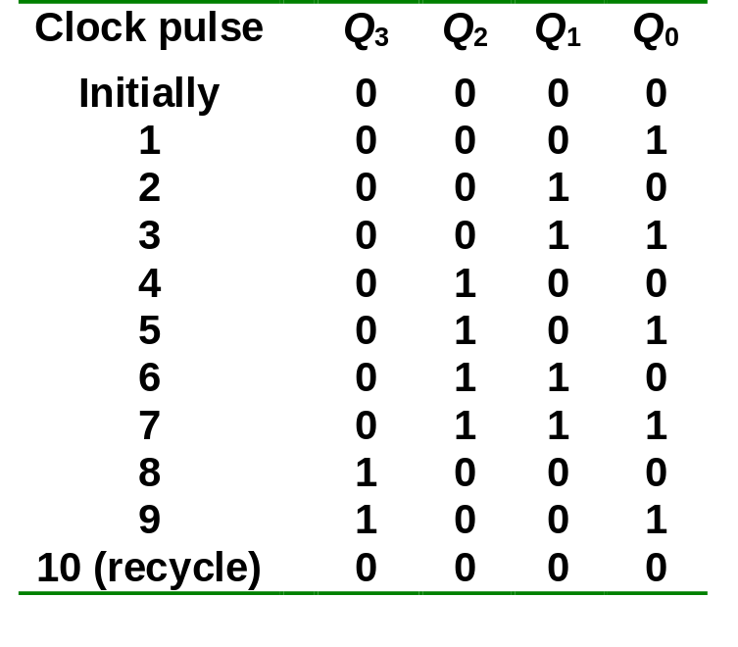
Synchronous (Parallel) Counters
Example: Synchronous decade/BCD counter.
T₀ = 1
T₁ = Q₃'.Q₀
T₂ = Q₁.Q₀
T₃ = Q₂.Q₁.Q₀ + Q₃.Q₀

Slide 10
Synchronous (Parallel) Counters
Example: Synchronous decade/BCD counter (cont’d).
T₀ = 1
T₁ = Q₃'.Q₀
T₂ = Q₁.Q₀
T₃ = Q₂.Q₁.Q₀ + Q₃.Q₀
Q₀
1
T
Q
T
Q₁
T
Q₂
T
Q₃
Q
Q
Q
Q
Q
Q
Q
C
C
C
C
Q'
Q'
Q'
Q'
Q'
Q'
Q'
Q'
CLK

Slide 11
Up/Down Synchronous Counters
Up/down synchronous counter: a bidirectional counter that is capable of counting either up or down.
An input (control) line Up/Down (or simply Up) specifies the direction of counting.
  Up/Down = 1 → Count upward
  Up/Down = 0 → Count downward

Slide 12
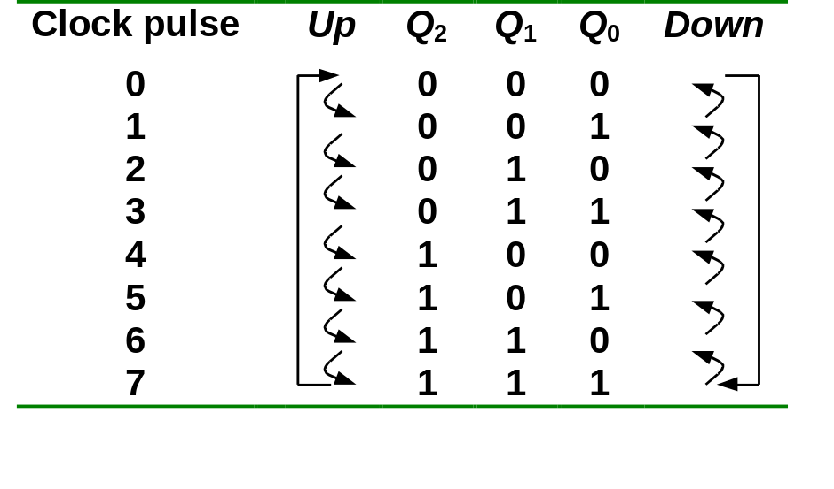
Up/Down Synchronous Counters
Example: A 3-bit up/down synchronous binary counter.
TQ₀ = 1
TQ₁ = (Q₀.Up) + (Q₀'.Up' )
TQ₂ = ( Q₀.Q₁.Up ) + (Q₀'. Q₁'. Up' )
Up counter
TQ₀ = 1
TQ₁ = Q₀
TQ₂ = Q₀.Q₁
Down counter
TQ₀ = 1
TQ₁ = Q₀’
TQ₂ = Q₀’.Q₁’

Slide 13
Up/Down Synchronous Counters
Example: A 3-bit up/down synchronous binary counter (cont’d).
TQ₀ = 1
TQ₁ = (Q₀.Up) + (Q₀'.Up' )
TQ₂ = ( Q₀.Q₁.Up ) + (Q₀'. Q₁'. Up' )
Q₀
Q₁
1
T
Q
T
T
Q₂
Q
Q
Q
Q
Q
Up
C
C
C
Q'
Q'
Q'
Q'
Q'
Q'
CLK

Slide 14
Asynchronous (Ripple) Counters
Asynchronous counters: the flip-flops do not change states at exactly the same time as they do not have a common clock pulse.
Also known as ripple counters, as the input clock pulse “ripples” through the counter – cumulative delay is a drawback.
This counter is also a frequency divider.

Slide 15
Asynchronous (Ripple) Counters
Example: 2-bit ripple binary counter.
Output of one flip-flop is connected to the clock input of the next more-significant flip-flop.
HIGH
J
Q₀
J
Q₁
CLK
C
Q₀
C
K
K
FF0
FF1
CLK
1
2
3
4
Q₀
Timing diagram
00 → 01 → 10 → 11 → 00 ...
Q₀
0
1
0
1
0
Q₁
0
0
1
1
0

Slide 16
Asynchronous (Ripple) Counters
Example: 3-bit ripple binary counter.
HIGH
J
Q₀
J
Q₁
J
Q₂
CLK
C
Q₀
C
Q₁
C
K
K
K
FF0
FF1
FF2
CLK
1
2
3
4
5
6
7
8
Q₀
0
1
0
1
0
1
0
1
0
Q₁
0
0
1
1
0
0
1
1
0
Q₂
0
0
0
0
1
1
1
1
0
Recycles back to 0

Slide 17
Asynchronous (Ripple) Counters
Example: 4-bit ripple binary counter (negative-edge triggered).
HIGH
J
Q₀
J
Q₁
J
Q₂
J
Q₃
CLK
C
C
C
C
K
K
K
K
FF0
FF1
FF2
FF3
CLK
1
2
3
4
5
6
7
8
9
10
11
12
13
14
15
16
Q₀
Q₁
Q₂
Q₃

Slide 18
Asynchronous (Ripple) Counters
Propagation delays in an asynchronous (ripple-clocked) binary counter.
If the accumulated delay is greater than the clock pulse, some counter states may be misrepresented!
CLK
1
2
3
4
Q₀
Q₁
Q₂
t_{PHL} (CLK to Q₀)
t_{PHL} (CLK to Q₀)
t_{PLH}
(CLK to Q₀)
t_{PLH} (Q₀ to Q₁)
t_{PHL} (Q₀ to Q₁)
t_{PLH} (Q₁ to Q₂)

Slide 19
Five Asynchronous Counter Examples: Must Practice at home
Modulus 7 Up Counter with Negative Edge Triggered Flip-Flops
Modulus 7 Down Counter with Negative Edge Triggered Flip-Flops
Modulus 7 Up Counter with Positive Edge Triggered Flip-Flops
Modulus 7 Down Counter with Positive Edge Triggered Flip-Flops
Truncated Counter

Slide 20
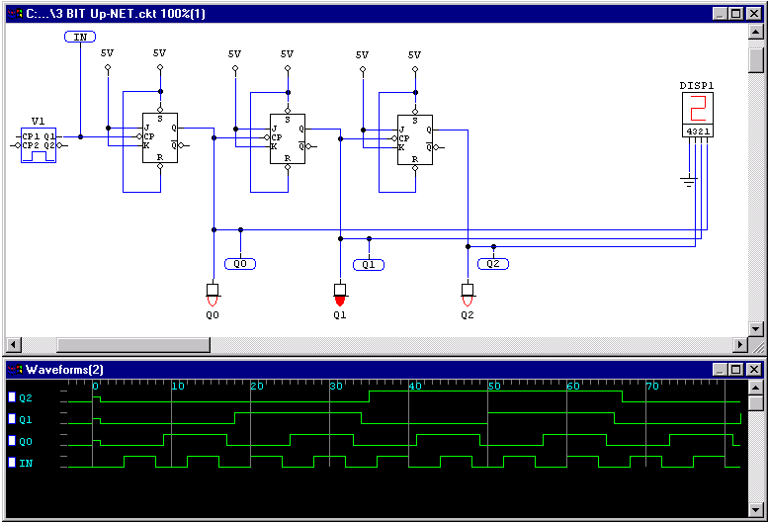
Up Counter w/ Negative Edge Flip-Flops
Ignore input of set(s)-reset( r)
Output includes propagation delay

Slide 21
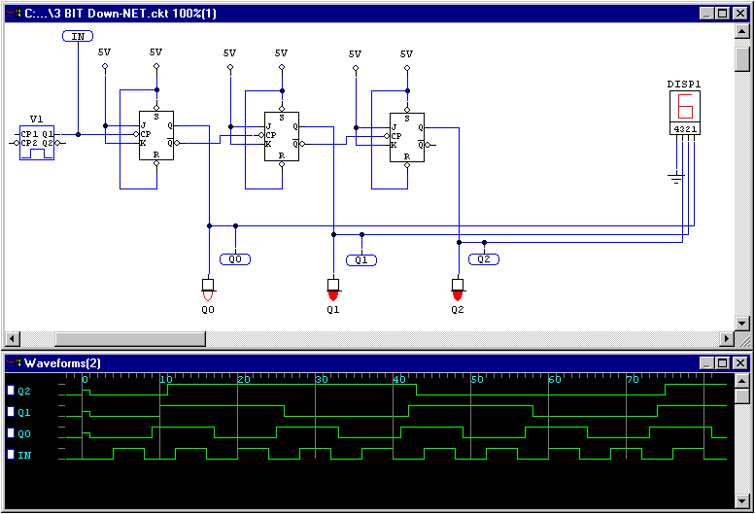
Down Counter w/ Negative Edge Flip-Flops
Ignore input of set(s)-reset( r)
Output includes propagation delay

Slide 22
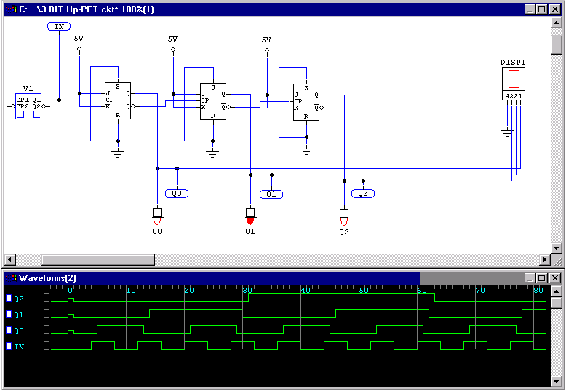
Up Counter w/ Positive Edge Flip-Flops
Ignore input of set(s)-reset( r)
Output includes propagation delay

Slide 23
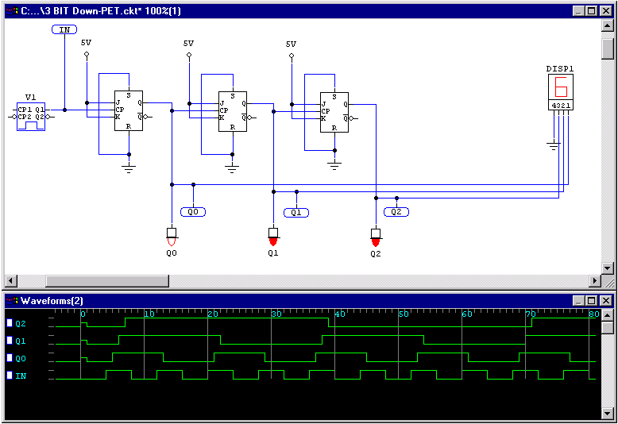
Down Counter w/ Positive Edge Flip-Flops
Ignore input of set(s)-reset( r)
Output includes propagation delay

Slide 24
Asyn. Counters with MOD no. < 2^{n}
States may be skipped resulting in a truncated sequence.
Technique: force counter to recycle before going through all of the states in the binary sequence.
Example: Given the following circuit, determine the counting sequence (and hence the modulus no.)
C
B
A
Q
J
Q
J
Q
J
All J, K inputs are 1 (HIGH).
CLK
CLK
CLK
Q
K
Q
K
Q
K
CLR
CLR
CLR
B
C

Slide 25
Asyn. Counters with MOD no. < 2^{n}
Example (cont’d):
C
B
A
Q
J
Q
J
Q
J
All J, K inputs are 1 (HIGH).
CLK
CLK
CLK
Q
K
Q
K
Q
K
CLR
CLR
CLR
B
C
1
2
3
4
5
6
7
8
9
10
11
12
MOD-6 counter produced by clearing (a MOD-8 binary counter) when count of six (110) occurs.
Clock
A
B
C
NAND
Output
1
0

Slide 26
Asyn. Counters with MOD no. < 2^{n}
Example (cont’d): Counting sequence of circuit (in CBA order).
1
2
3
4
5
6
7
8
9
10
11
12
Clock
A
0
0
0
1
0
0
0
1
0
1
1
0
0
0
1
1
0
1
0
0
0
1
0
0
B
C
NAND
Output
1
0
111
000
Temporary state
001
Counter is a MOD-6 counter.
110
010
101
011
100

Slide 27
Summary: Asynchronous Counter Design Steps
Select Type
    Up or Down
    Modules
Select Flip-Flop Type
    J-K or T
    Positive Edge Trigger (PET) or Negative Edge Trigger (NET)
Determine Number of Flip-Flops
    (2^{# Flip-Flop} ≥ Modules)

Slide 28


Summary: Asynchronous Counter Design Steps
Design Basic Counters
    down counters:
    up counters:
Design Limits Logic for MOD
    Input to logic(i.e. input of clear) is count that is one past the end of sequence.

Slide 29
Asyn. Counters with MOD no. < 2^{n}
Decade counters (or BCD counters) are counters with 10 states (modulus-10) in their sequence. They are commonly used in daily life (e.g.: utility meters, odometers, etc.).
Design an asynchronous decade counter.
(A.C)'
HIGH
J
Q
D
J
Q
C
J
Q
B
J
Q
A
CLK
C
C
C
C
K
K
K
K
CLR
CLR
CLR
CLR

Slide 30
Asyn. Counters with MOD no. < 2^{n}
Asynchronous decade/BCD counter (cont’d).
HIGH
D
C
B
A
J
Q
J
Q
J
Q
J
Q
(A.C)'
CLK
C
C
C
C
K
K
K
K
CLR
CLR
CLR
CLR
1
2
3
4
5
6
7
8
9
10
11
Clock
D
0
0
0
0
1
0
0
0
0
1
0
0
1
1
0
0
0
0
1
0
1
0
1
0
0
1
1
0
1
1
1
0
0
0
0
1
1
0
0
1
0
0
0
0
C
B
A
NAND
output

